Slide 1


Place your PV logo here
Foundational Course in Entrepreneurship
Milestone 1
Institute – B.S. Abdur Rahman Crescent Institute of Science & Technology
P.V. – RISE (Rider Instructed Sharing Environment)

Slide 2
INTRODUCTION
Business Name: RISE
PV ID: 25419
Transport is a major problem to many Student and Employees , we are here to
present the best solution for this problem. We are developing a application
where people can rent their extra seats in cars or bike , inside or outside the
campus . As of now , our prototype is said to deliver riders seat sharing
facility only inside and a short distance from the campus.
We are also planning to add more features
like delivery of their goods or belongings through a personal of their own
organization in the future.

Slide 3
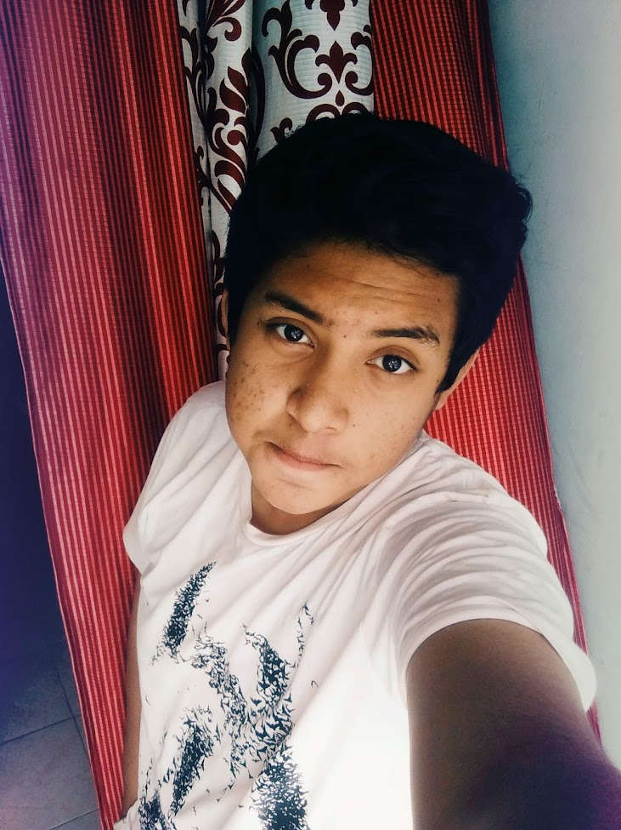

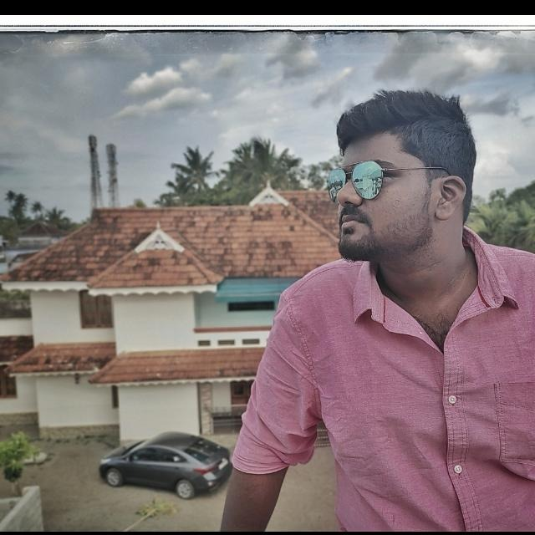
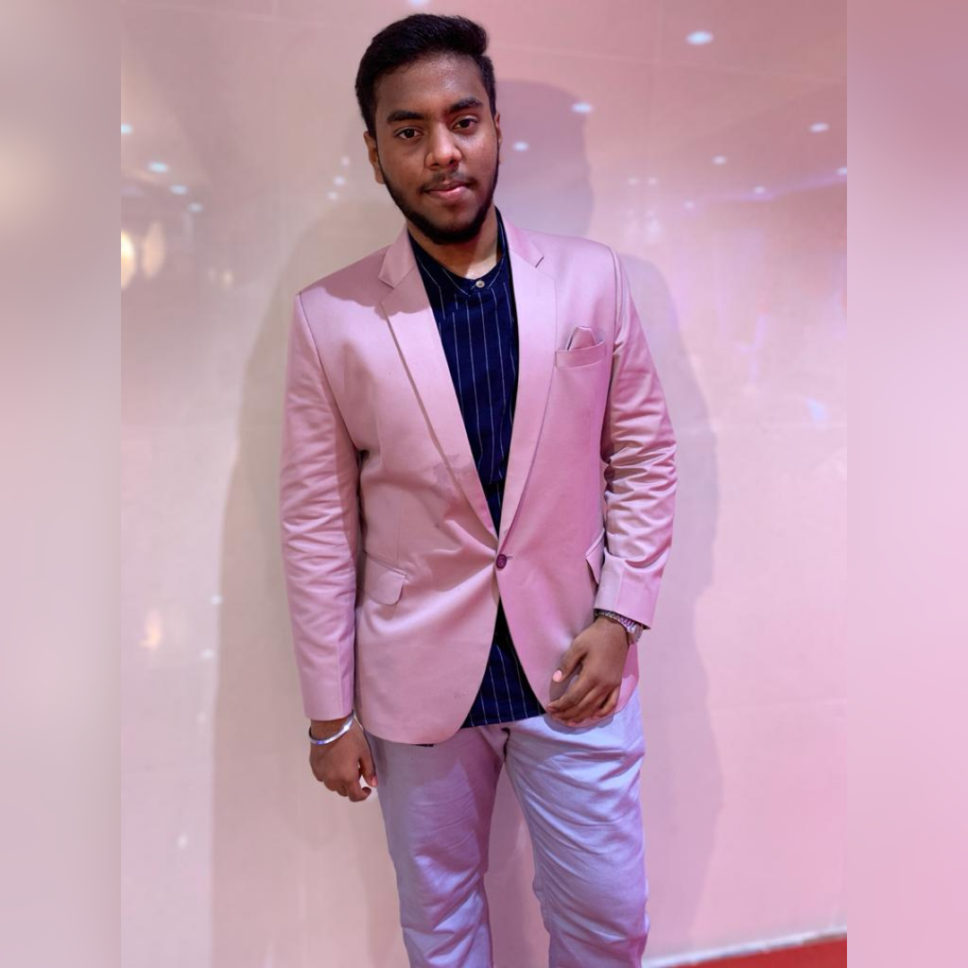
TEAM COMPOSITION
Tharun S.M.
Shamse Ahmad
Sheik Hussain S.H.
M Yasar Khan
Team members names | Strengths and abilities | Role/Position
Tharun S.M. | Creative & Innovative | CEO
Shamse Ahmad | Quick adapter & Motivator | CTO
Sheik Hussain S H | Hardworking & Good listener | CMO
Mohammed Yasar Khan | Friendly & Collaborative | COO
What makes us a good team to solve the problem we chose?
The Different Ideas and thought process makes us a very good team to solve a problem Collaboratory. We also aid each other in aspects in which we lack in knowledge .
“ Powerful people don’t come from powerful places,
they make places Powerful ”

Slide 4

PROBLEM
Problem definition:
With longer distances to reach destination, there is a necessity of a short term transport which needs to be fulfilled
We found that approximately 75 % of the customers that we interviewed are facing this problem.
Existing Alternatives:
Rapido, Uber, Ola
We used the following tools to arrive at these findings: Online Survey, in-person Campus Interviews and Phone Calls
Notes:
Evaluation Criteria for slides 4 and 5
1. Problem definition: Have you identified & described clearly the problem that you want to solve? (2 marks) 2. Problem validation: a. Have you interviewed customers or taken customer surveys (at least 25 for B2C and 2 for B2B) to find out whether you feel the problem is a must-to-solve one? (1 mark) b. Have you analysed the customer feedback that you have received and compiled & presented it (e.g. as a graphical representation or pie-chart? (2 marks)

Slide 5
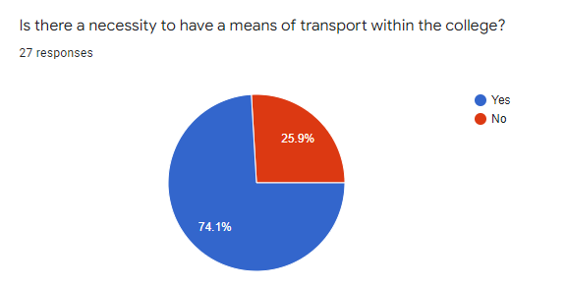
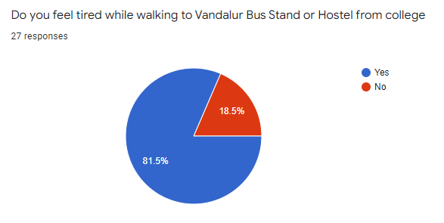
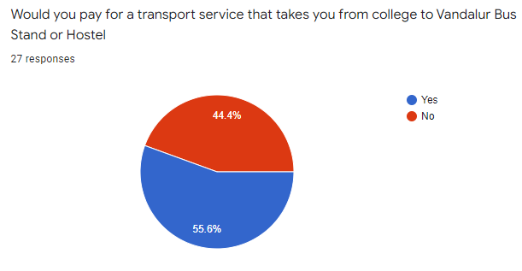
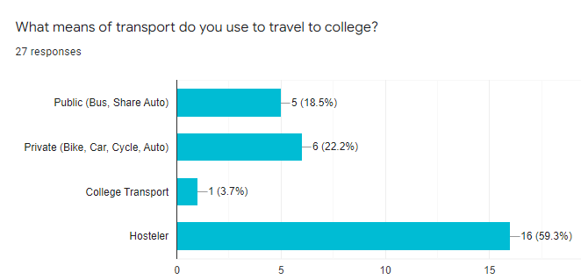
Interviews/surveys data
Survey Link
 | Results
How many customers did you interview? (At least 25 for B2C and 2 for B2B) | 27
How many of them agree this is a problem that needs to be solved? | 74%
How many of them said they can already solve this problem and don't need a new solution? | 26%

Slide 6
CUSTOMER
 | Results
What is your Market type? | Transport Network Company (TNC)
What is/are your Customer Segment(s)? | Mass Market
What is your TAM - Total Addressable Market? | 70 000
What is your SAM – Serviceable Addressable Market? | 15 000
What is your SOM – Serviceable Obtainable Market?(Near Vandalur) | 3 000 – 5 000
What is your Niche? | Organizational Transportation and Service for people in and around Vandalur
Notes:
Evaluation Criteria for slides 6 and 7
1. Market Discovery - a. Have you correctly identified the Market type? (1 mark) b. Customer Segment Size: i. Have you identified correctly the TAM - (1 mark) ii. Have you identified correctly you SAM and SOM- (1 mark) 2. Customer Discovery - c. Have you been able to identify their Niche? (1 mark) d. Have you been able to draw out the right Customer Persona ? (1 mark)

Slide 7
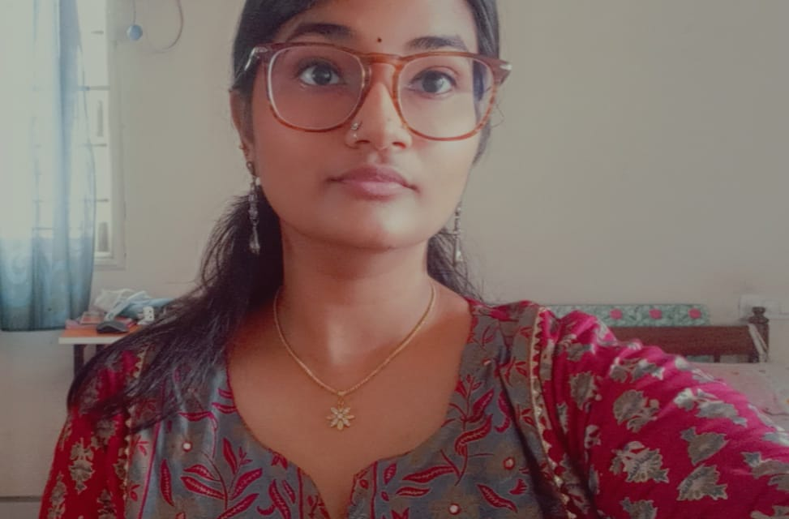
CUSTOMER PERSONA (PRESENT CUSTOMER PERSONA FOR ALL CUSTOMER SEGMENTS)
Insert your customer’s picture/photo
Intelligent
Generous
Insightful
Goals
Time Saving
Money Saving
Fuel Saving
Energy Saving
Motivations
Frustrations
Creates time impunctuality
Waste of energy
Walking in hot/sunny climate
Won't have to walk a lot
Can get early to classes
Can trust on the drivers
A studious student who doesn’t want any delay in her work
Age (in years): 20
Gender: Female
Profession: Student
Location: ECR
Bio
Meet Rishika Saaju, an engineering student who studies in B.S. Abdur Rahman Crescent Institute of Science and Technology. Rishika is an forensic enthusiast and keeps researching about it daily on the internet. She strives to become a very good Cyber Forensic Researcher. Generally, she doesn’t like sharing rides with unknown personal and also hates walking or using the public transport, This is we provided her a solution and she was happy with our service and also rides participated in our test rides.
Personality
A fun, entertaining and very knowledgeable person to interact with

Slide 8
VALUE PROPOSITION CANVAS
Place your PV logo here
Discount on first rides
Monthly Subscriptions
I would LOVE it if:
Time is being saved
Service cost is less
Transport for customers from college to bus stand
I would WANT:
Scan QR code and enter pickup/drop location with time of the ride
Use a web-based application to book the ride (or)
Call or message on WhatsApp to book a ride
GAIN CREATORS
GAINS
PRODUCT
/SERVICE
JOBS
PAINS
PAIN KILLERS
Reach on time
Time Saving
Cost Saving
I would HATE it if:
Fuel expenses go high
There is no safety
There is time impunctuality
.

Slide 9
LEAN CANVAS
Place your PV logo here
PROBLEM
#Passenger
Inconvenient travel for
organization’s employees and students, high expenses on travel
#Riders
Extra income, less consumption on overall fuel.
EXISTING ALTERNATIVES
#Rider #Passenger
Rapido, Uber bikes, OLA
Bike & OLA Share
SOLUTION
Transport Sharing with the personal from the same organization.
UNIQUE VALUE PROPOSITION
Earn Extra Cash
Trustworthy riders
Share extra seats
UNFAIR ADVANTAGE
Contracts with organizations.
Early acquiring of student/employee database from organizations.
CUSTOMER SEGMENTS
#Passenger
Daily traveler
Public transport users
Organizational employees
Organizational students
#Riders
Bikers
Car riders
EARLY ADOPTERS
Employees/Students who are in a urgent and need for a ride.
Femail employees/ students who need a trusted and convent means of travel.
KEY METRICS
No. of rides booked
No. of available
drivers
No. of searches
CHANNELS
Word of mouth
Social media
Poster & adds
Complementary rides
COST STRUCTURE
Website and online database
Advertising
User verification/validation
REVENUE STREAMS
Ride booking fees
Monthly subscriptions
Online use data marketing
Notes:
Evaluation Criteria for slide 10
Check the following on Lean Canvas: 1. Do the problem, customer, and solution boxes talk to each other i.e. are they telling a story? (1 mark) 2. Is the UVP box aligned to the Value proposition segment of the VPC? (1 mark) 3. Have you identified the right major cost segments and revenue streams for the venture? (1 mark) 4. Have you identified the right metrics to evaluate the health of their venture? (1 mark) 5. Have you identified the right channels? (1 mark)

Slide 10
THANK YOU

